Slide 1
Python Programming – I (Introduction)
- By Nimesh Kumar Dagur, CDAC Noida, India

Slide 2
Introduction to Python programming
Python is a widely used general-purpose, high-level programming language.
Its design philosophy emphasizes code readability, and its syntax allows programmers to express concepts in fewer lines of code than would be possible in languages such as C.
Python supports multiple programming paradigms, including object-oriented and functional programming or procedural styles.
Python was developed by Guido van Rossum in the late eighties and early nineties at the National Research Institute for Mathematics and Computer Science in the Netherlands.

Slide 3
Introduction to Python programming
Python is Interpreted
Python is Interactive
Python is Object-Oriented
Python is Beginner's Language
x
value

Slide 4
Python's feature
Easy-to-learn: relatively few keywords, simple structure, and a clearly defined syntax
Easy-to-read: much more clearly defined and visible to the eyes
Easy-to-maintain: source code is fairly easy-to-maintain. (Module & package)
A broad standard library: bulk of the library is very portable and cross-platform compatible on UNIX, Windows and Macintosh
Portable : run on a wide variety of hardware platforms and has the same interface on all platforms.

Slide 5
Package
Sub-package1
Sub-package2
Module3
ModuleN
Module1
Module2
Functions
Simple statement,
Expressions,
variable,constants
Classes
Built-in
Functions
User Defined
Functions
Methods, attributes,
Properties, variable,
Constructors,
destructors

Slide 6
Python's feature
Extendable: You can add low-level modules to the Python interpreter. These modules enable programmers to add to or customize their tools to be more efficient.
Databases: Python provides interfaces to all major commercial databases.
GUI Programming: Python supports GUI applications that can be created and ported to many system calls, libraries and windows systems.
Scalable: Python provides a better structure and support for large programs.

Slide 7
Running Python:
There are three different ways to start Python:
(1) Interactive Interpreter: You can enter python and start coding right away in the interactive interpreter by starting it from the command line.
C:>python
(2) Script from the Command-line: A Python script can be executed at command line by invoking the interpreter on your application, as in the following:
C:>python script.py

Slide 8
(3) Integrated Development Environment : PythonWin is the first Windows interface for Python and is an IDE with a GUI.

Slide 9
Python Identifiers:
A Python identifier is a name used to identify a variable, function, class, module or other object.
An identifier starts with a letter A to Z or a to z or an underscore (_) followed by zero or more letters, underscores and digits (0 to 9).
Python does not allow punctuation characters such as @, $ and % within identifiers.
Python is a case sensitive programming language. Thus, Manpower and manpower are two different identifiers in Python.

Slide 10
Reserved Words:
Reserved words may not be used as constant or variable or any other identifier names.
Most of the Python keywords contain lowercase letters .

Slide 11
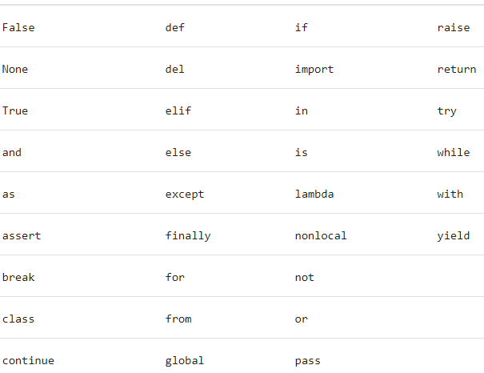
Reserved Words:

Slide 12

Lines and Indentation:
One of the first caveats programmers encounter when learning Python is the fact that there are no braces to indicate blocks of code for class and function definitions or flow control. Blocks of code are denoted by line indentation, which is rigidly enforced.
The number of spaces in the indentation is variable, but all statements within the block must be indented the same amount.
(
)
(
)

Slide 13
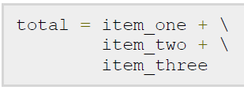
Multi-Line Statements
Statements in Python typically end with a new line.
Python does, however, allow the use of the line continuation character (\) to denote that the line should continue.

Slide 14

Multi-Line Statements
Statements contained within the [], {} or () brackets do not need to use the line continuation character

Slide 15

Quotation in Python:
Python accepts single ('), double (") and triple (''' or """') quotes to denote string literals, as long as the same type of quote starts and ends the string.
The triple quotes can be used to span the string across multiple lines.

Slide 16
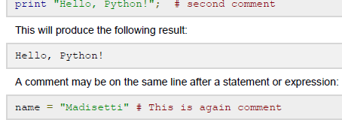
Comments in Python:
A hash sign (#) that is not inside a string literal begins a comment.
All characters after the # and up to the physical line end are part of the comment and the Python interpreter ignores them.
(
)

Slide 17
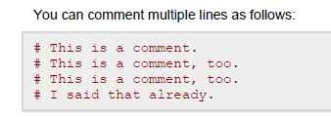

Slide 18
Python variable
Variables are nothing but reserved memory locations to store values.
when you create a variable you reserve some space in memory.
Based on the data type of a variable, the interpreter allocates memory and decides what can be stored in the reserved memory.
Therefore, by assigning different data types to variables, you can store integers, decimals or characters in these variables.

Slide 19
Assigning Values to Variables:
Python variables do not have to be explicitly declared to reserve memory space.
The declaration happens automatically when you assign a value to a variable.
The equal sign (=) is used to assign values to variables.

Slide 20
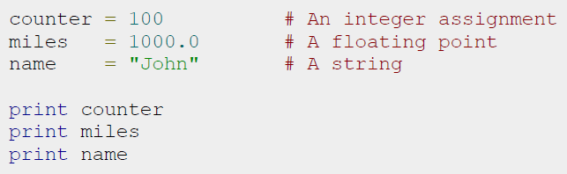
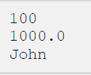
Assigning Values to Variables:
(
)
(
)
(
)

Slide 21


Multiple Assignment:
Python allows you to assign a single value to several variables simultaneously
Here, an integer object is created with the value 1, and all three variables are assigned to the same memory location.
You can also assign multiple objects to multiple variables.

